Slide 1
Tutorial #4 Data visualization

Slide 2
Agenda
Different plot types
Exercises:
Exercise: Visualizations of four different data sets.
Optional exercise: Make interactive plots using ggiraph.
Optional exercise: Rstudio Cloud primer on visualizations.

Slide 3
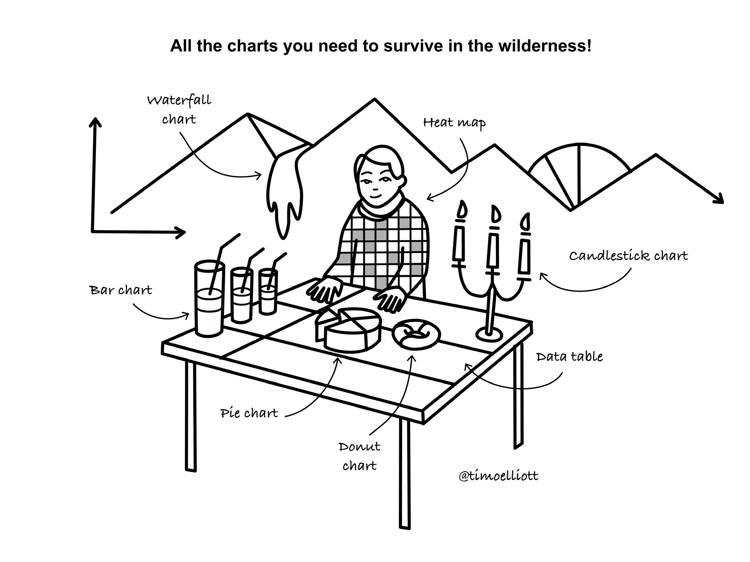

Slide 4
Line plot
Bar plots
Box plots
Density plots
Scatter plots
Word clouds
Pie chart
Raincloud plot
Heatmap
Animated plots
(Interactive plots)

Slide 5
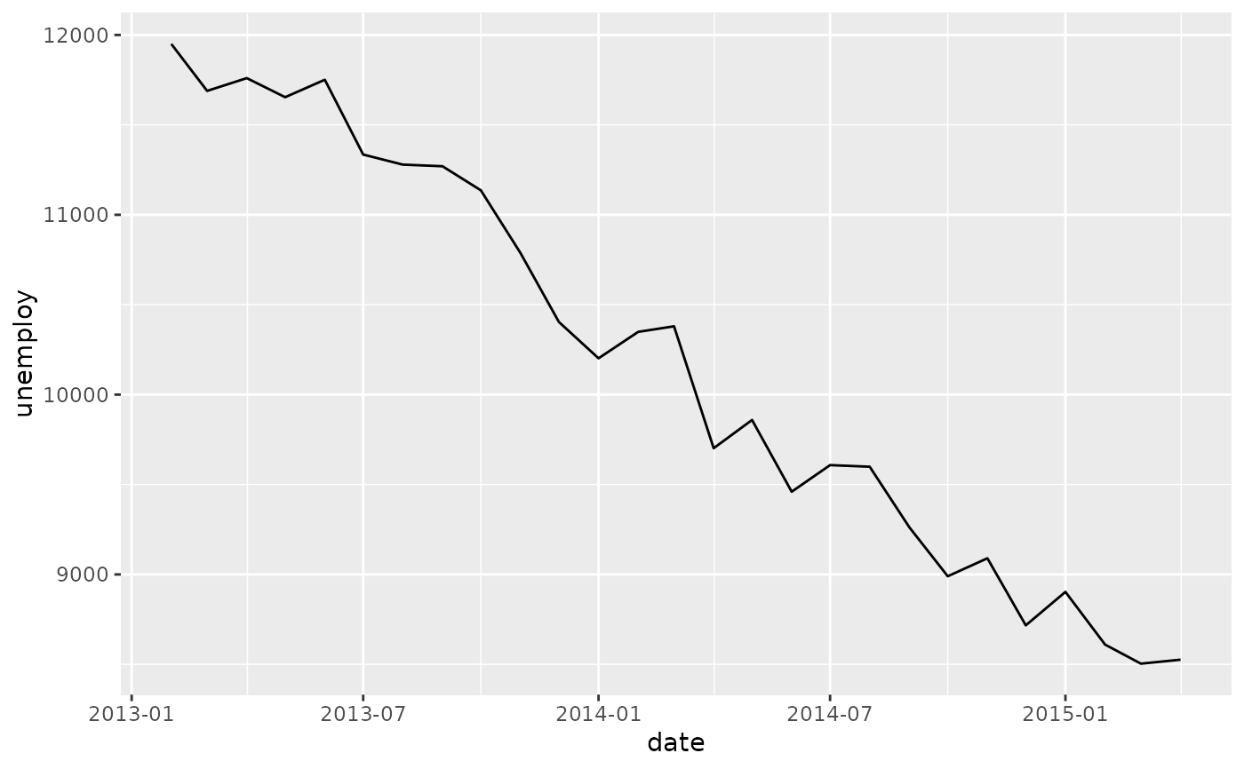
Line plot
Bar plots
Box plots
Density plots
Scatter plots
Word clouds
Pie chart
Raincloud plot
Heatmap
Animated plots
(Interactive plots)

Slide 6
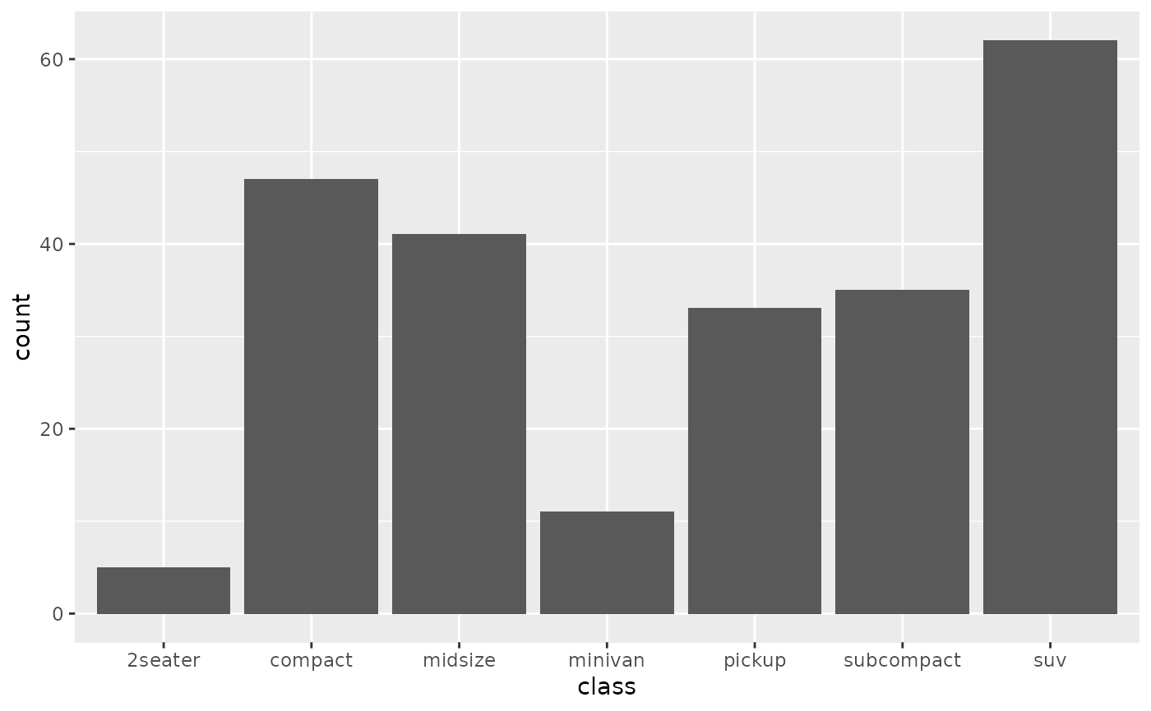
Line plot
Bar plots
Box plots
Density plots
Scatter plots
Word clouds
Pie chart
Raincloud plot
Heatmap
Animated plots
(Interactive plots)

Slide 7
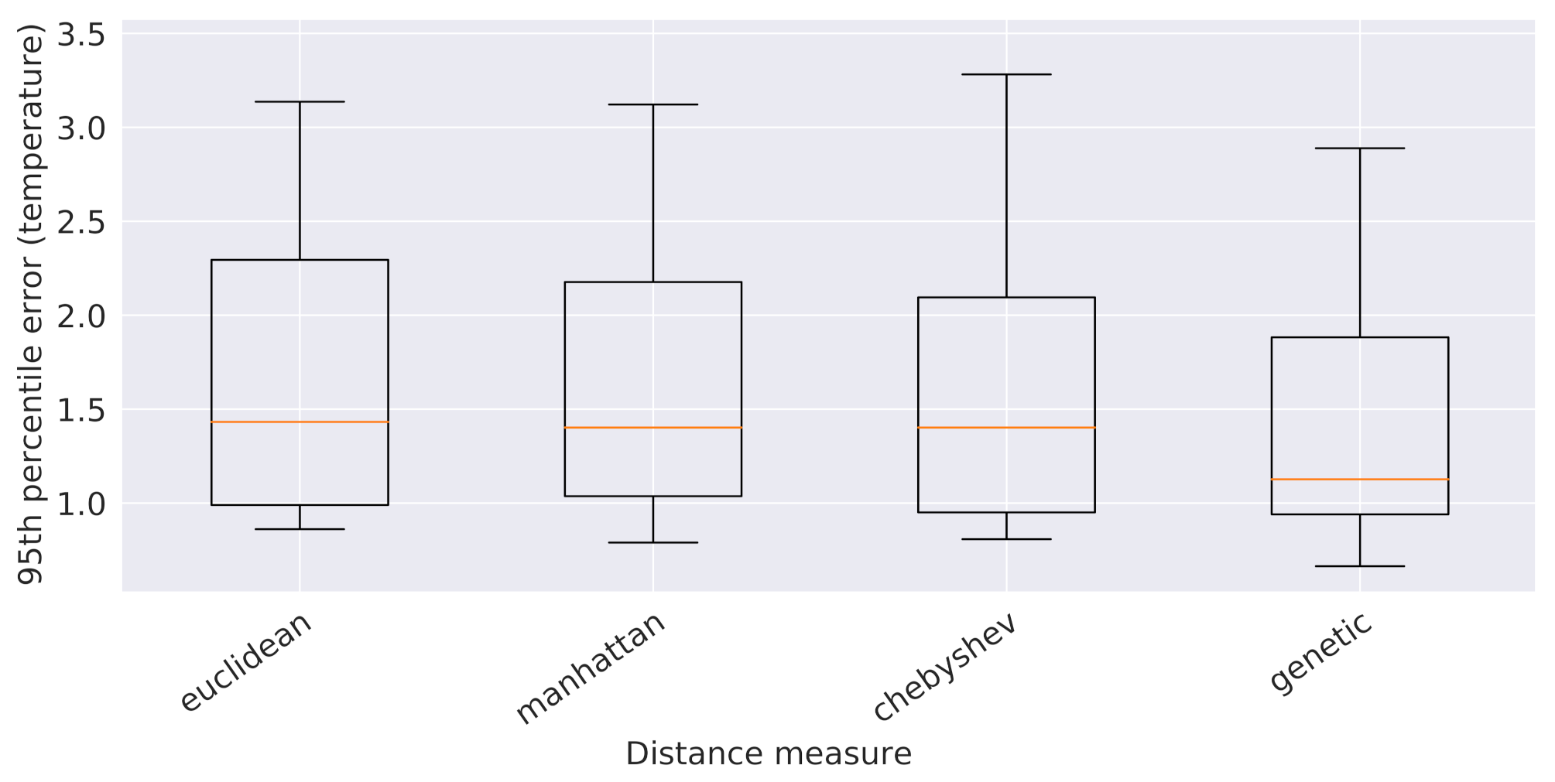
Line plot
Bar plots
Box plots
Density plots
Scatter plots
Word clouds
Pie chart
Raincloud plot
Heatmap
Animated plots
(Interactive plots)

Slide 8
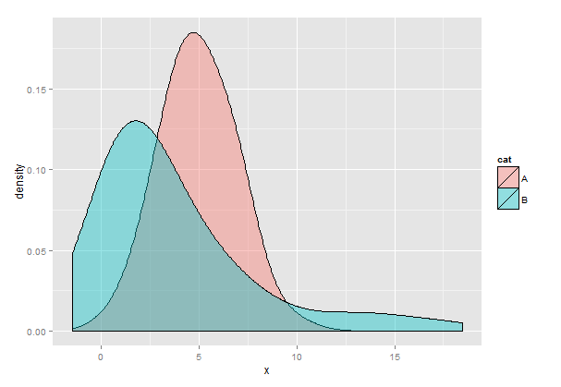
Line plot
Bar plots
Box plots
Density plots
Scatter plots
Word clouds
Pie chart
Raincloud plot
Heatmap
Animated plots
(Interactive plots)

Slide 9
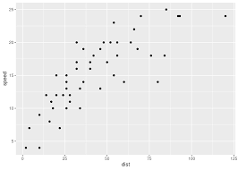
Line plot
Bar plots
Box plots
Density plots
Scatter plots
Word clouds
Pie chart
Raincloud plot
Heatmap
Animated plots
(Interactive plots)

Slide 10
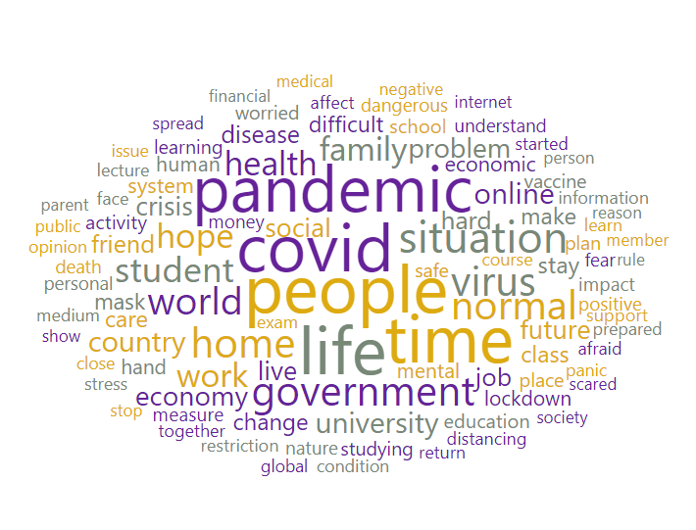
Line plot
Bar plots
Box plots
Density plots
Scatter plots
Word clouds
Pie chart
Raincloud plot
Heatmap
Animated plots
(Interactive plots)

Slide 11
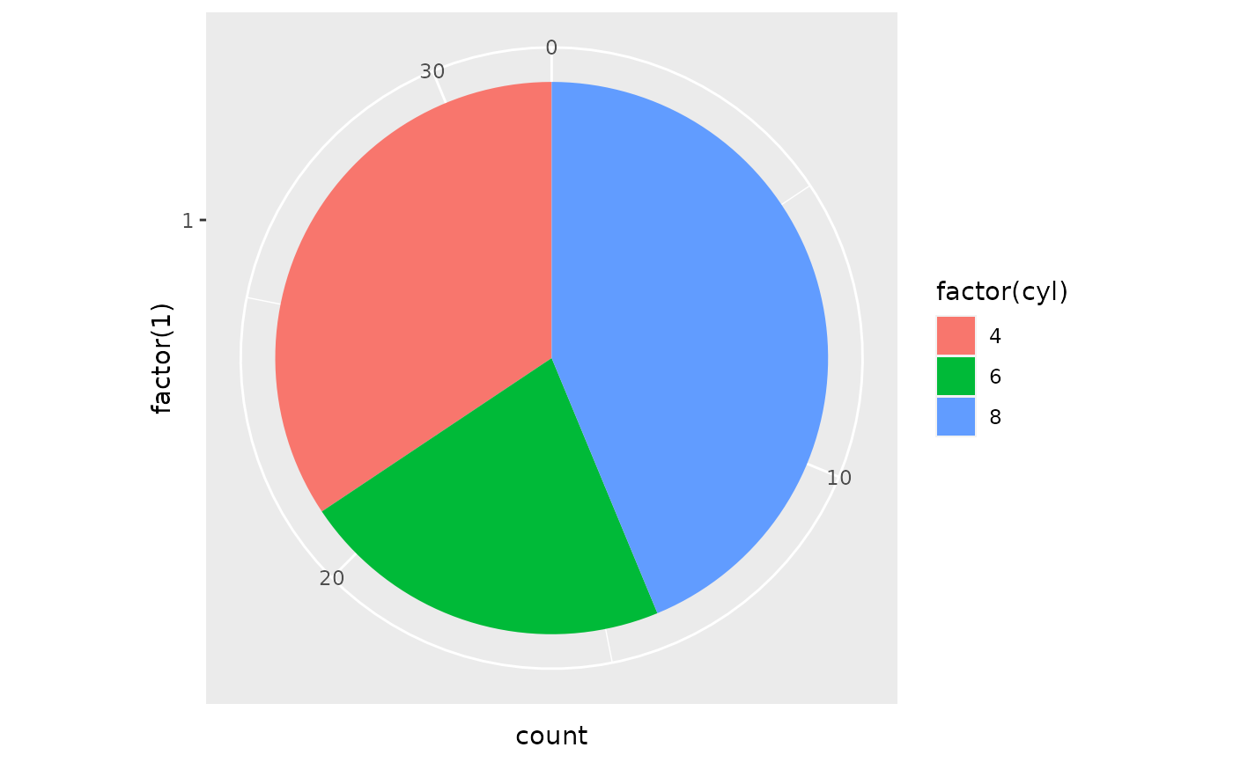
Line plot
Bar plots
Box plots
Density plots
Scatter plots
Word clouds
Pie chart
Raincloud plot
Heatmap
Animated plots
(Interactive plots)

Slide 12
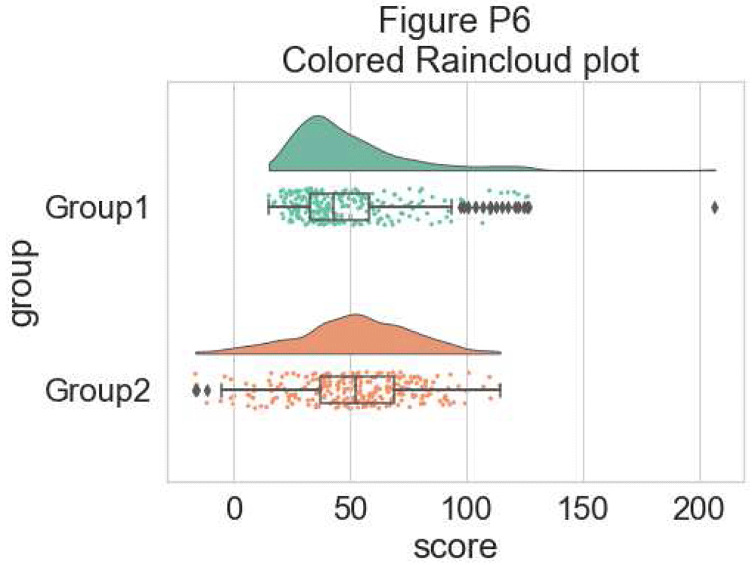
Line plot
Bar plots
Box plots
Density plots
Scatter plots
Word clouds
Pie chart
Raincloud plot
Heatmap
Animated plots
(Interactive plots)

Slide 13
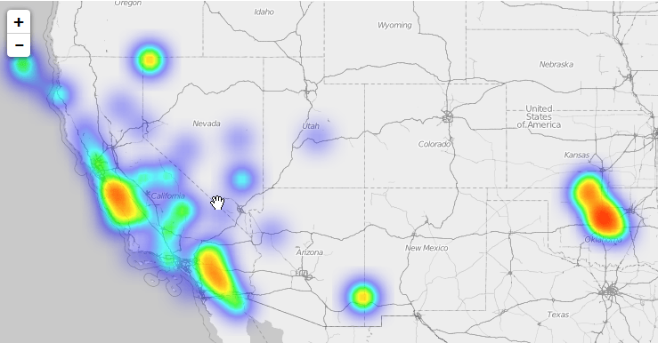
Line plot
Bar plots
Box plots
Density plots
Scatter plots
Word clouds
Pie chart
Raincloud plot
Heatmap
Animated plots
(Interactive plots)

Slide 14
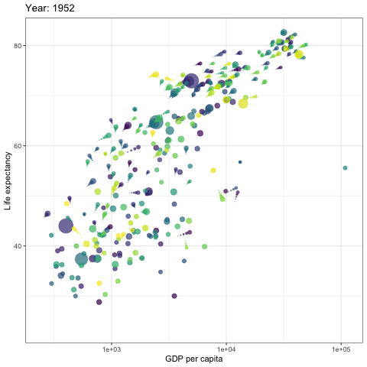
Line plot
Bar plots
Box plots
Density plots
Scatter plots
Word clouds
Pie chart
Raincloud plot
Heatmap
Animated plots
(Interactive plots)

Slide 15
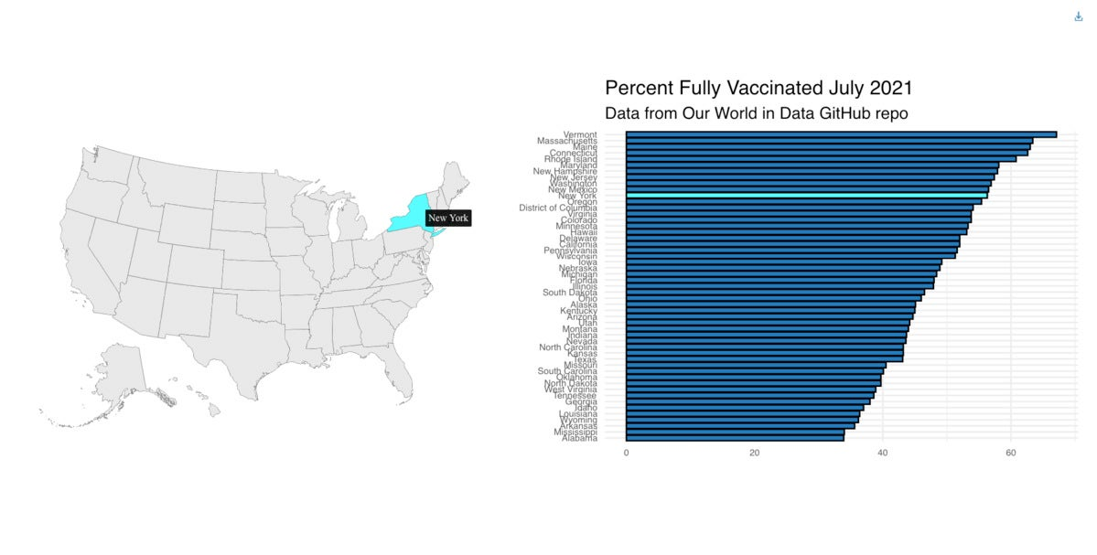
Line plot
Bar plots
Box plots
Density plots
Scatter plots
Word clouds
Pie chart
Raincloud plot
Heatmap
Animated plots
(Interactive plots)

Slide 16
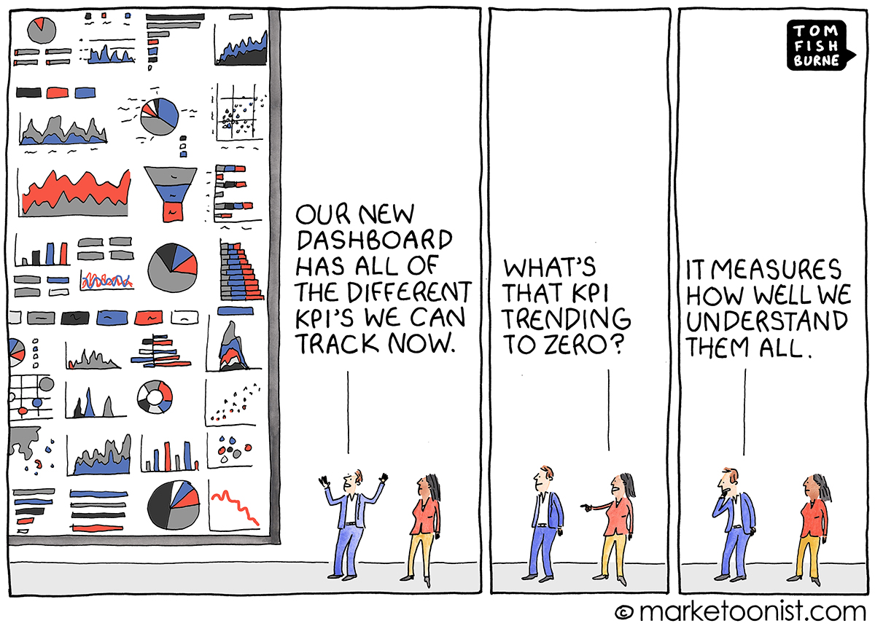

Slide 17
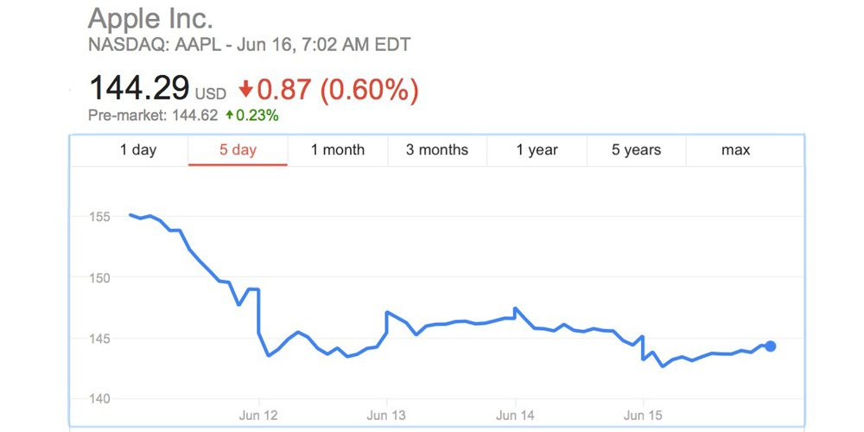

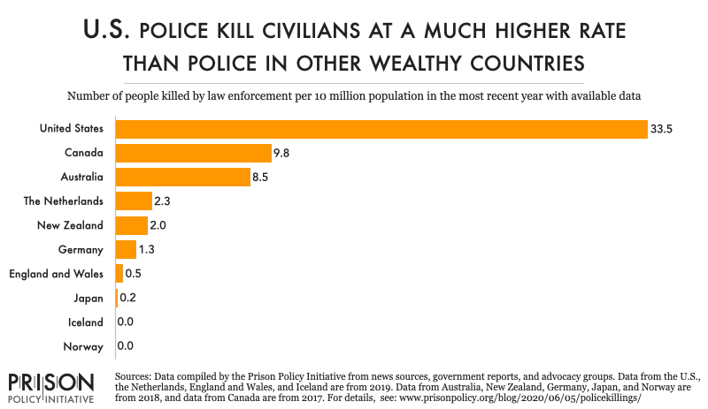
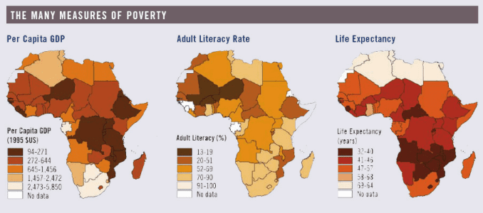
Exercise: Visualizations in r

Slide 18
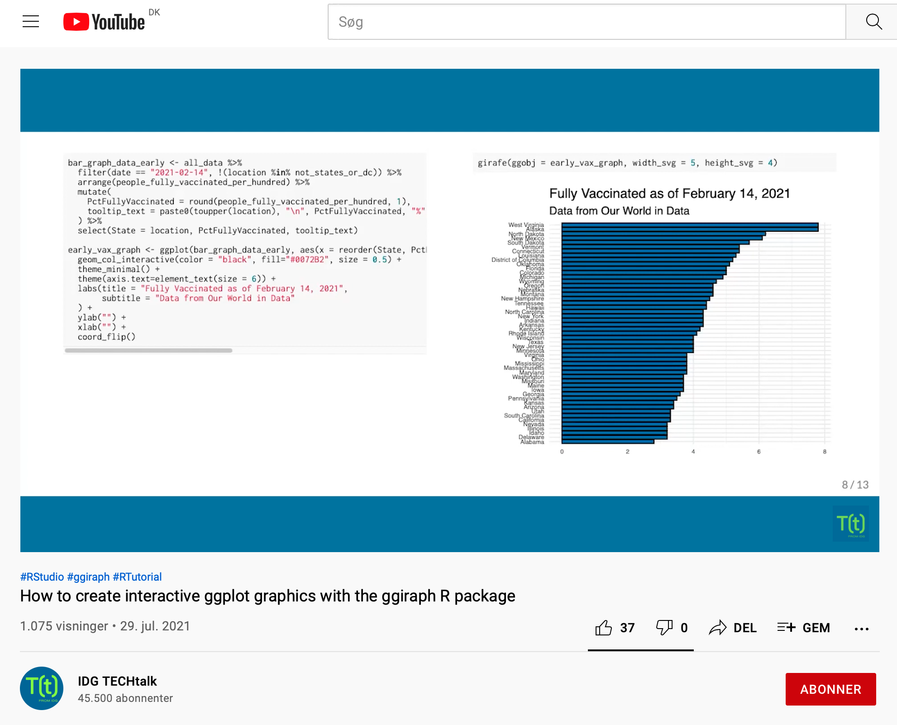

Optional exercie: ggiraph
https://www.infoworld.com/article/3626911/easy-interactive-ggplot-graphs-in-r-with-ggiraph.html

Slide 19

Optional exercise: Rstudio cloud primer
https://rstudio.cloud/learn/primers/3

Slide 20
Next time
Date: 07.10.2021
Topic: Exploratory data analysis
Exercise: Explore a dataset I provide. Gather insights. Present.
Before class: Finish exercises in “Tutorial4_visualizations.Rmd” script.

